Slide 1




Slide 2


Slide 3
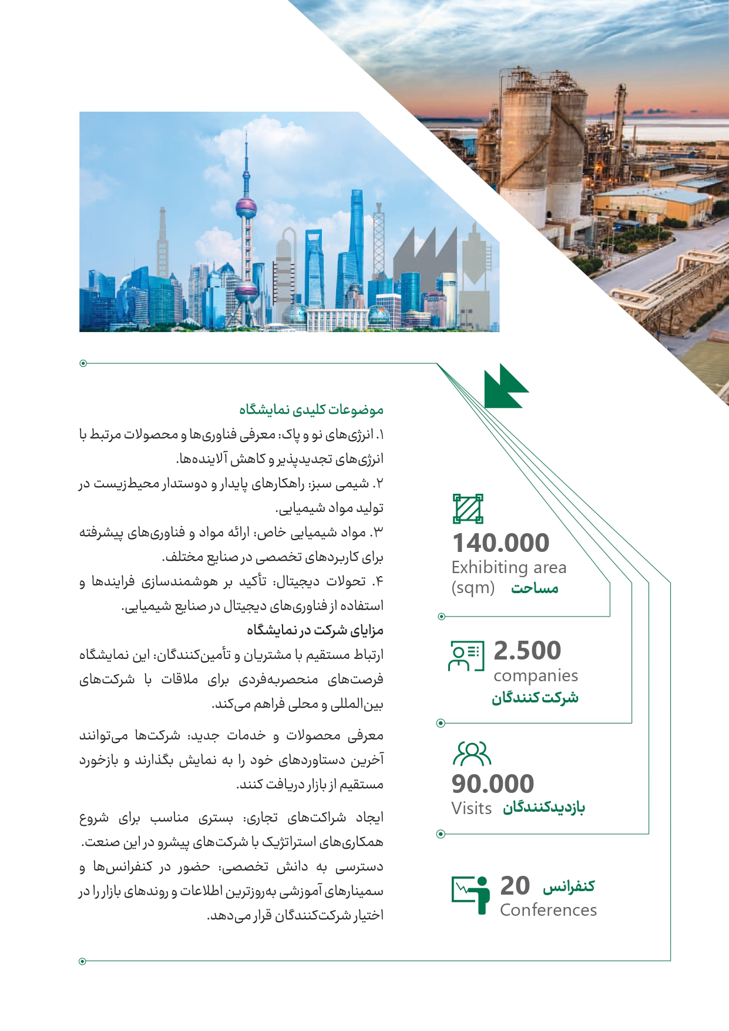

Slide 4


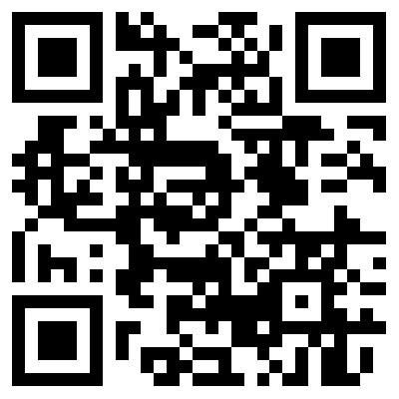




WWW.HERMESBI.COM
info@hermesbi.com
02154512
09356302419

